Slide 1
Financial Highlights
As of October 31, 2025
One Minute Report – Click Below

Slide 2

Highlights of Interim Financial Report (unaudited)
October 31, 2025

Slide 3





Posted on Our Website
Finance / Monthly Finance Reports (hcde-texas.org)
Linked from State Comptroller’s website
http://www.texastransparency.org/local/schools.php

Slide 4
Top 13 Highlight points for October 2025
$683 in tax revenue this month
Next Debt Svc payment is Feb 2026
GF Revenues at 10%
GF Expenditures at 19%
$35M in Equity(F Bal) as of October 2025
$14,426 October Donations
Values at $688B as Projected
Choice at $1.8M Benefit Variance
Ed Foundation at $233K in Equity
31% small business - October 2025
99% Irvington Project
Phase I Projects – just pending retainage release and closeout
Arbitrage payment due on Jan 31st - $101,820
Outlook Trend : Finance - Tax Revenues being received – Projected to utilize fund balance for operations given unrealized revenues (Unassigned projected $24M)
Revenues and exp. Below target
Operations - Normal Operations
Legislative - Assessing Impact to HCDE
Finance - Assessing grant awards pending

Slide 5
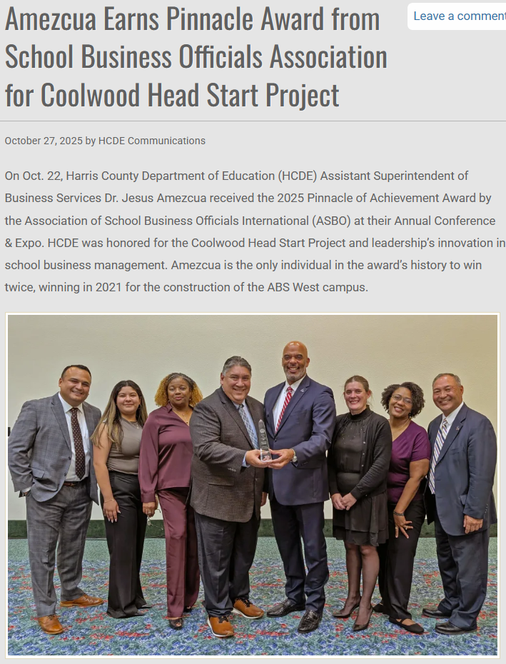
ASBO Pinnacle Award
#2

Slide 6




HCDE receives financial reporting awards
HCDE received the ASBO Award for FY 24-25 & FY 25-26 Annual Budget
HCDE received the ASBO Award for Financial Reporting FY 23-24
HCDE received the GFOA Award for FY 24-25 Annual Budget
HCDE received the GFOA Award for Certificate of Financial Reporting for FY 23-24
HCDE submitted for two awards from TASBO
AOM Purchasing Award
AEFP Financial Performance
Projected for December 2025

Slide 7
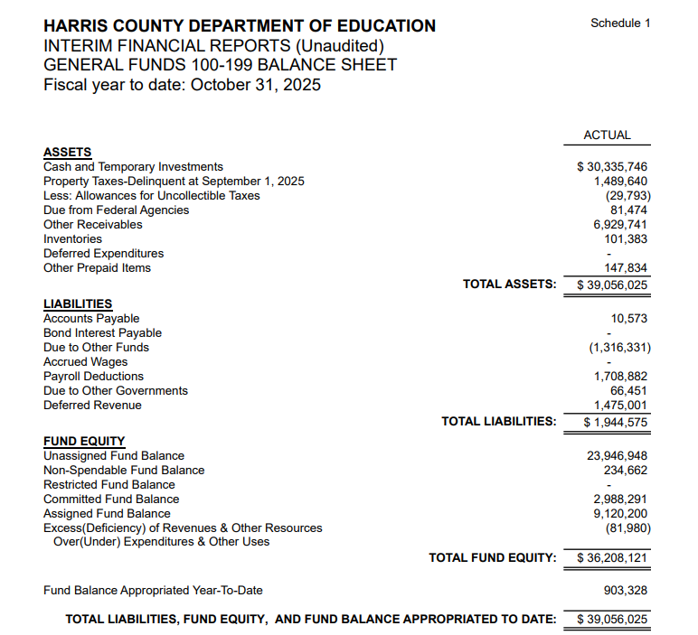
INTERIM FINANCIAL REPORT (unaudited) GENERAL FUND
Balance Sheet as of October 31, 2025
Total Assets:
$ 39,056,025
Total Liabilities:
$ 1,944,575
Total Fund Equity:
$36,208,121

Slide 8
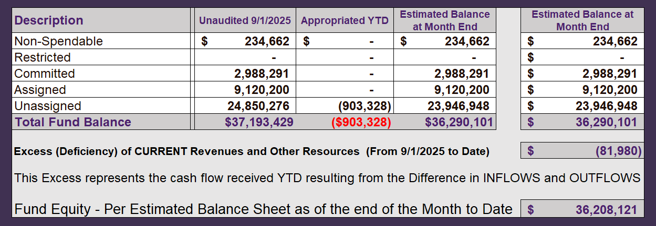
INTERIM FINANCIAL REPORT (unaudited) ASST. SUPERINTENDENT FOR BUSINESS SERVICES MESSAGE As of October 31, 2025
The ESTIMATED General Fund balance at 10/31/2025 is $36,208,121 after current appropriations.
As year end adjustments are completed, a budget amendment will be submitted to the board for items assigned, restricted and committed that will roll forward into FY 2025.

Slide 9
INTERIM FINANCIAL REPORT (unaudited) As of October 31, 2025 Financial Ratios
Level One - Indicator of Financial Strength
Level Two - Indicator of Efficient Leverage
Level Three - Indicators of Efficiency
Level Four - Indicators of Revenue Growth

Slide 10
INTERIM FINANCIAL REPORT (unaudited) As of October 31, 2025 Indicators of Financial Strength
Percent of Fund Balance to G/F
Expenditures Ratio
What is the percent of rainy-day fund balance?
(*) Unadjusted
Working Capital Ratio
What is the cash flow availability for the organization?
Unassigned Fund Balance $24,850,277
Total G/F Expenditures $10,045,079
Goal : > 30% of G/F Exp.
Benchmark: 10% to 29%
Danger: Under 10%
Goal : >$15,000,000
Benchmark : $10M to $15M
Danger : Under < $10M
Total Current Assets
Less Total Current Liabilities
$40,372,356 - $3,260,906= $37,111,450
247% FY26
274% FY25
$37M FY26
$30M FY25
Budgeted 29%
Details on Schedule 3
Budgeted $33M
Details on Schedule 1

Slide 11
INTERIM FINANCIAL REPORT (unaudited) As of October 31, 2025 Indicators of Efficient Leverage Reserves
Unassigned Fund Balance Ratio
How much is available in reserves?
Debt to Income Ratio
What is the ability of HCDE to cover
its debt payments?
Goal: <25% of annual revenue
Benchmark: 25% to <49%
Danger: Over > 50%
Unassigned Fund Balance $24,850,277
Total Fund Balance $37,111,450
Goal: <75%
Benchmark: 50% to 75%
Danger: <50%
Annual Principal and Interest Payments on
Term Debt and Capital Leases : $0
G/F Revenue Less Facility $9,963,099-1,661,604
Charges :
64% FY26
88% FY25
0% FY26
0% FY25
Budgeted 30%
Details on Schedule 1
Budgeted 5%
Details on Schedule 5

Slide 12
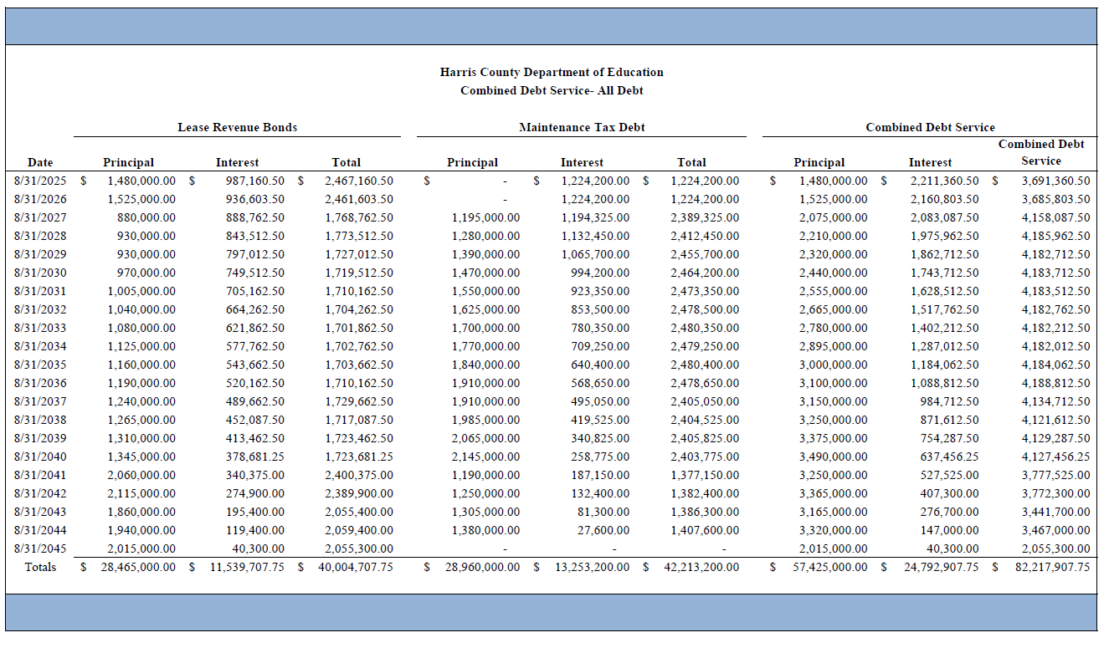
Combined Debt

Slide 13
INTERIM FINANCIAL REPORT (unaudited) As of October 31, 2025 Indicators of Efficiency
Tax Revenue to Total Revenue Ratio
How efficient is HCDE at leveraging local
taxes? (Current)
Indirect Cost to Tax Ratio
How much dependency on indirect cost from grants?
Current Tax Revenue $683
Total Revenue $14,922,477
Indirect Cost General Fund $22,382
Total General Fund Revenues $9,963,099
Goal: <20% of revenue
Benchmark: 20% to 30%
Danger: Over >30%
Goal: >5%
Benchmark: 2% to 5%
Danger: Under < 2%
0% FY26
0% FY25
.2% FY26
4.1% FY25
Budgeted 20%
Details on Schedule 2
Budgeted 3.6%
Details on Schedule 3

Slide 14
INTERIM FINANCIAL REPORT (unaudited) As of October 31, 2025 Indicators of Revenue Growth
Fee for Service Revenue Ratio
How are revenues spread across all Funds?
Fee for Service Revenue Growth Ratio
What is the market growth for fee on services?
Total Fee for Service Revenues (G/F) $7,659,128
Total Revenues $14,922,477
Fee for Service Current Year Less Fee for Services Last Year $7,659,128 - 1,722,572
Fees for Service Last Year $1,722,572
Goal: >30% of annual revenue Benchmark: 10% to 29%
Danger: Under 10%
Goal: >3% of + growth
Benchmark: 0% to 3%
Danger: Under 0%
51% FY26
15% FY25
344% FY26
-75% FY25
Budgeted 39%
Details on Schedule 14
Budgeted 17%
Details on Schedule 14

Slide 15
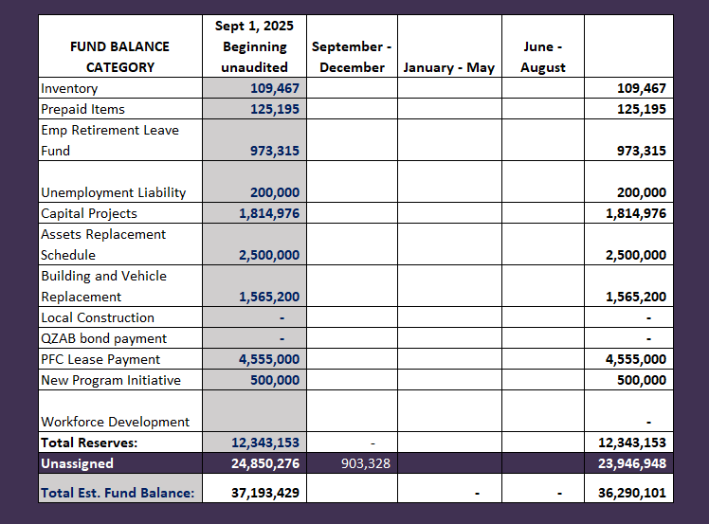
FY 2025-2026 Fund Balance - Budgeted Activity
Previous BAs
Durotech Change Order | $903,328

Slide 16
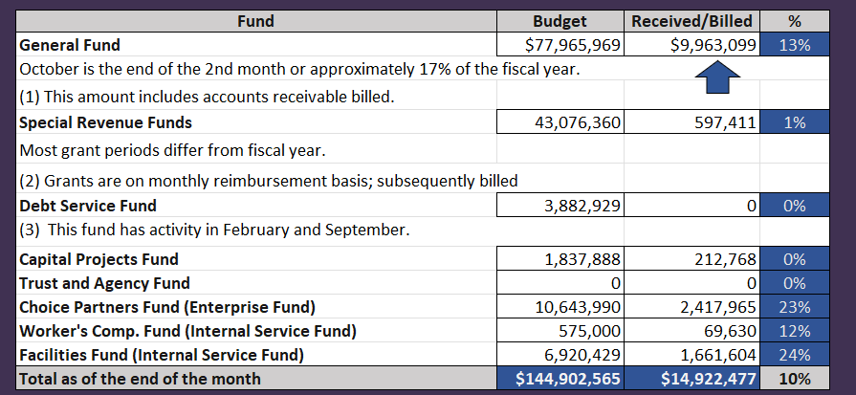
INTERIM FINANCIAL REPORT (unaudited) GENERAL, SPECIAL REVENUE, DEBT SERVICE FUNDS, CAPITAL PROJECTS,
AND INTERNAL SERVICE FUNDS
REVENUES (INFLOWS)
Budget to Actual for period ending October 31, 2025

Slide 17
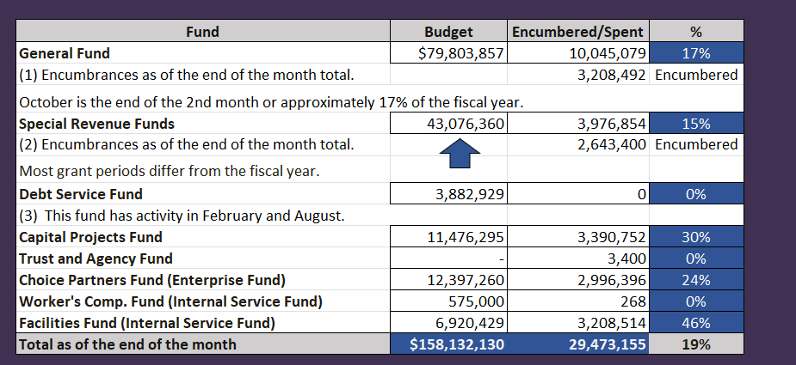
INTERIM FINANCIAL REPORT (unaudited) GENERAL, SPECIAL REVENUE, DEBT SERVICE FUNDS, CAPITAL PROJECTS,
AND INTERNAL SERVICE FUNDS
Expenditures (OUTFLOWS)
Budget to Actual for period ending October 31, 2025

Slide 18
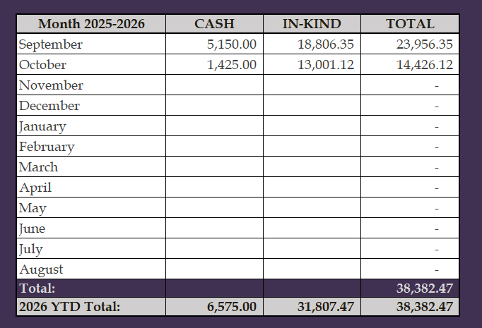
INTERIM FINANCIAL REPORT (unaudited) FY 2025-26 Donations Report All Funds as of October 31, 2025

Slide 19
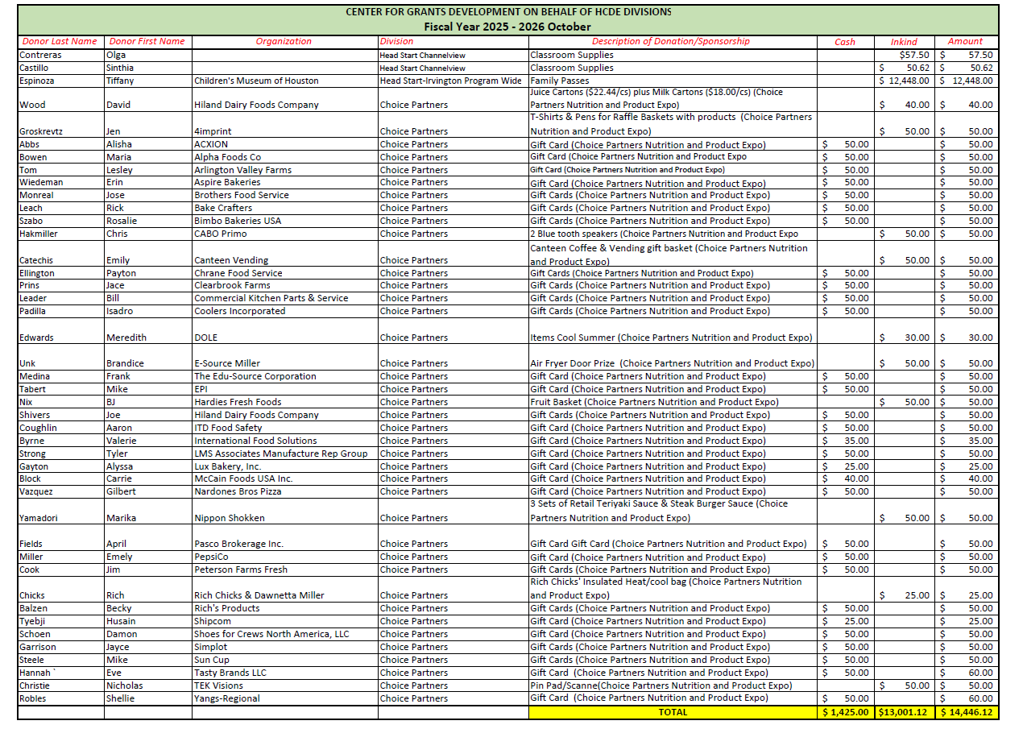
INTERIM FINANCIAL REPORT (unaudited) FY 2025-26 Donations Report All Funds as of October 31, 2025

Slide 20
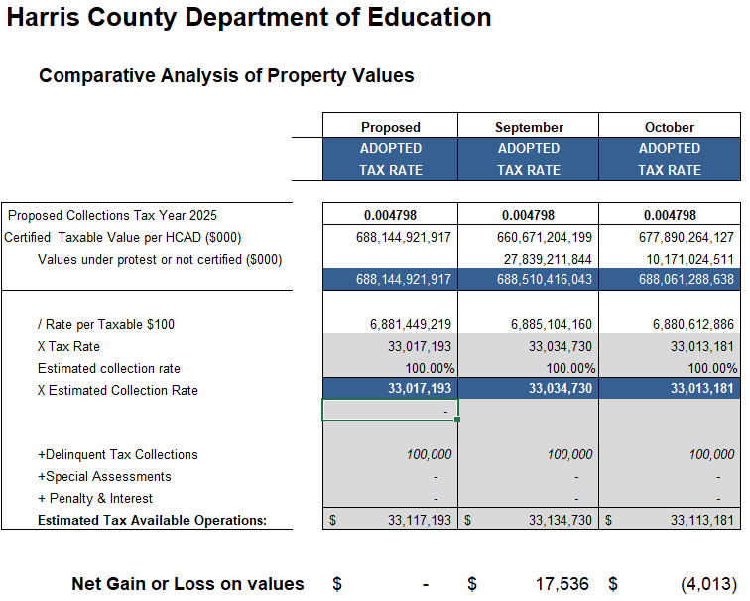
INTERIM FINANCIAL REPORT (unaudited) TAX COLLECTIONS COMPARATIVE ANALYSIS Fiscal Year-To-Date as of October 31, 2025
$688B
$688B
See Tax Calculator at:
https://hcde-texas.org/transparency/tax-rate/

Slide 21
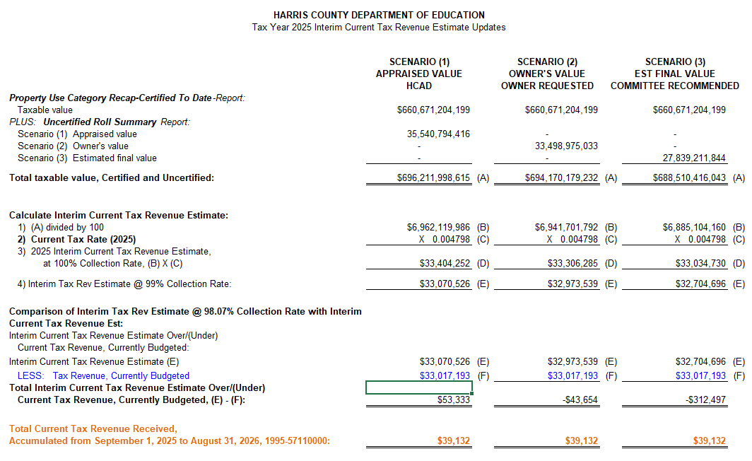
INTERIM FINANCIAL REPORT (unaudited) TAX COLLECTIONS Fiscal Year-To-Date as of October 31, 2025 (2nd month / 12 months)

Slide 22
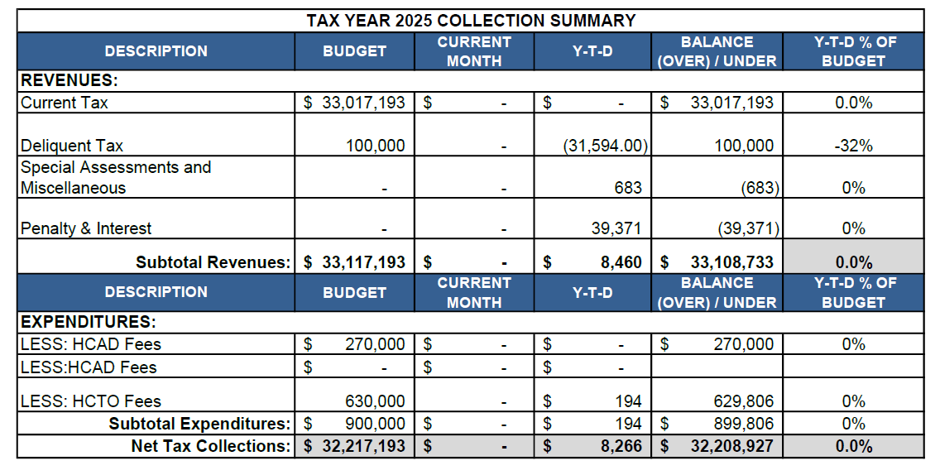
INTERIM FINANCIAL REPORT (unaudited) TAX COLLECTIONS Fiscal Year-To-Date as of October 31, 2025 (2nd month / 12 months)
a) 2024 Approved Tax Rate = $0.004799/$100 Property Assessment/Appraisal - --> Annual Tax on a $259,375 - $51,875 = $207,500/100
x .004799 = $9.958 (net of 20% homestead exception.)
b) $850,000/$32,184,041 = 2.64% Collection and assessment costs

Slide 23
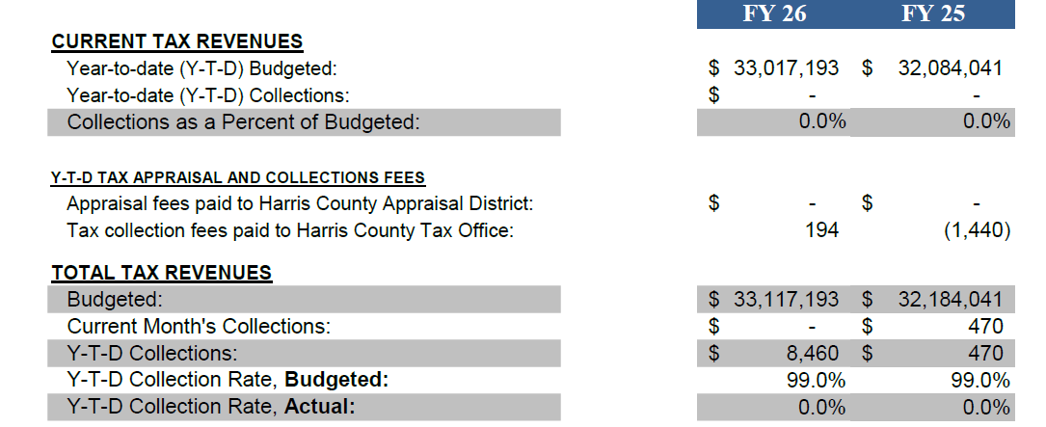
INTERIM FINANCIAL REPORT (unaudited) TAX COLLECTIONS Fiscal Year-To-Date as of October 31, 2025 (2nd month / 12 months)
a) 2024 Approved Tax Rate = $0.004799/$100 Property Assessment/Appraisal - --> Annual Tax on a $259,375 - $51,875 = $207,500/100
x .004799 = $9.958 (net of 20% homestead exception.)
b) $850,000/$32,184,041 = 2.64% Collection and assessment costs

Slide 24
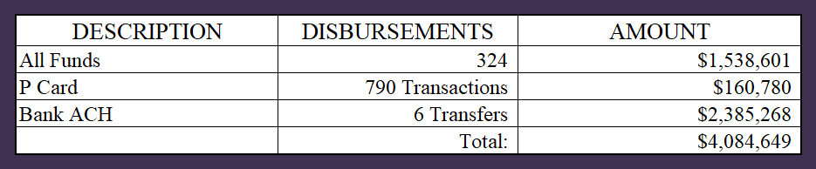
INTERIM FINANCIAL REPORT (unaudited) DISBURSEMENT – ALL FUNDS October 31, 2025
Notes:
All Purchase Orders and Payment Authorizations are reviewed before disbursement.
All Procurement Card charges are reviewed by cardholder, supervisor, and business office staff each month.
A report on CH Local Expenditures is included in the monthly report.

Slide 25
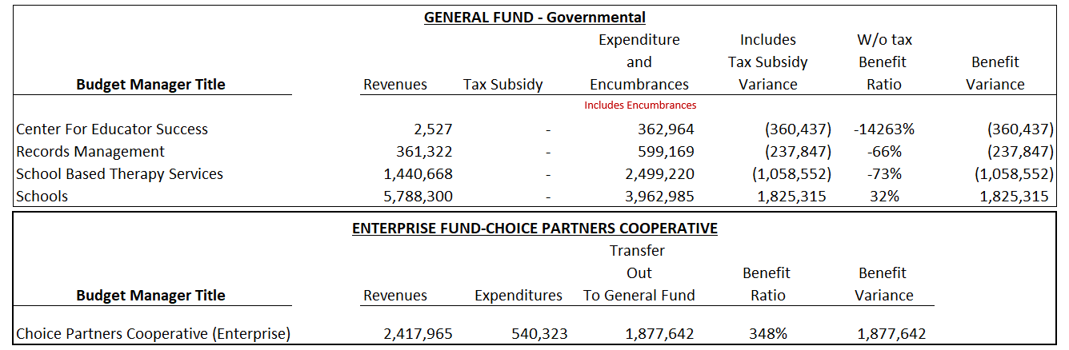
INTERIM FINANCIAL REPORT (unaudited) Segment Division Data As of October 31, 2025

Slide 26
HIGHLIGHTS OF BUDGET AMENDMENT REPORT November 19th, Board Meeting (unaudited)
No Budget Amendments for the month of November

Slide 27

Education Foundation Update
October 31, 2025

Slide 28
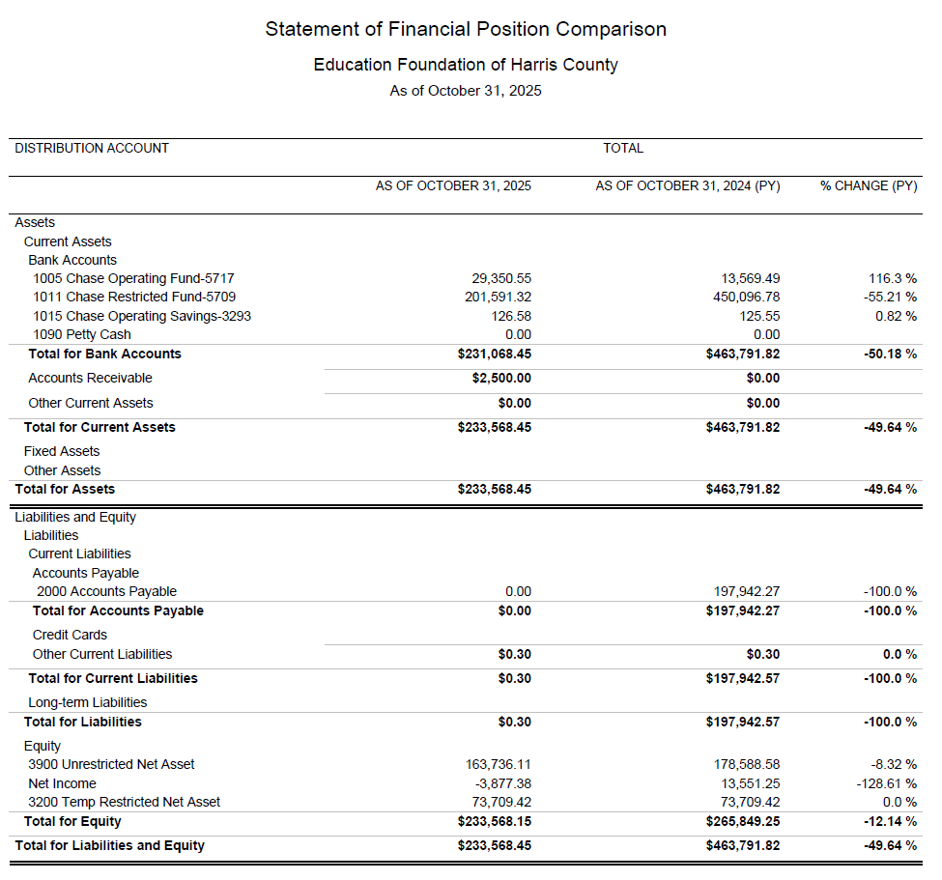
Statement of Financial Position
Net Equity
$233,568

Slide 29
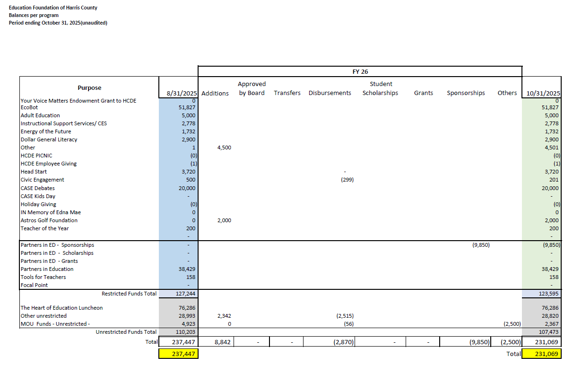
Summary of Foundation Programs

Slide 30
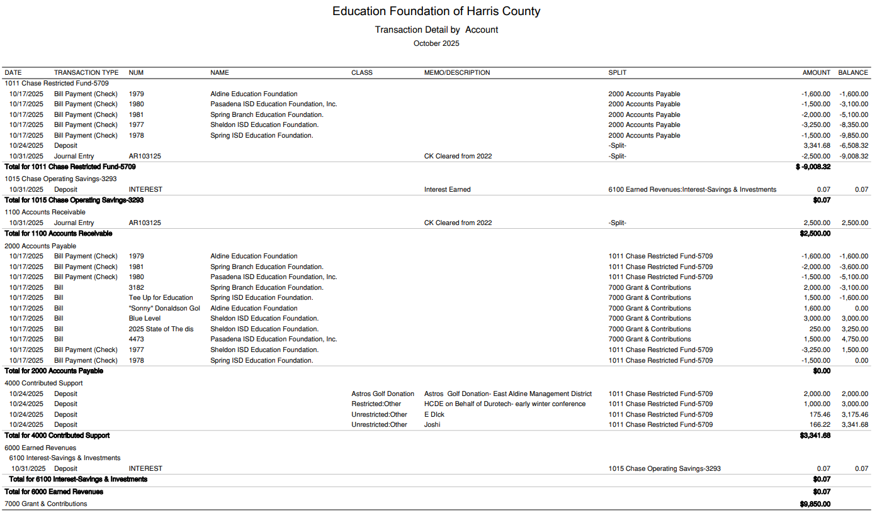
Transaction Detail by Inflow & Outflow

Slide 31
PFC & LEASE REVENUE PROJECTS UPDATE
October 31, 2025

Slide 32
Small Business Report FY2025-26 09/01/25 to 08/31/26
Submitted by:
Dr. Edna E. Johnson,
Procurement Services Director

Slide 33
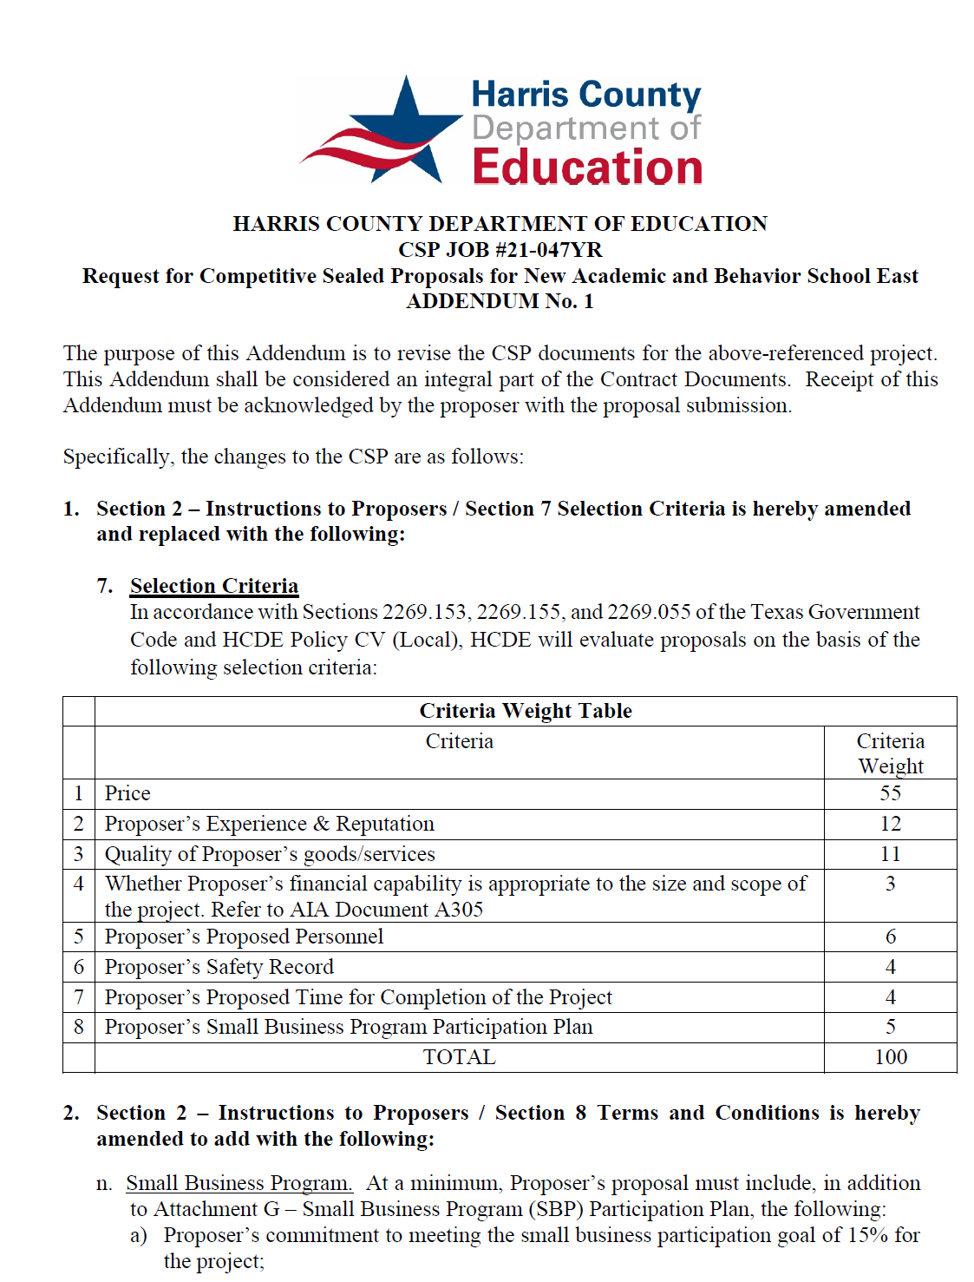
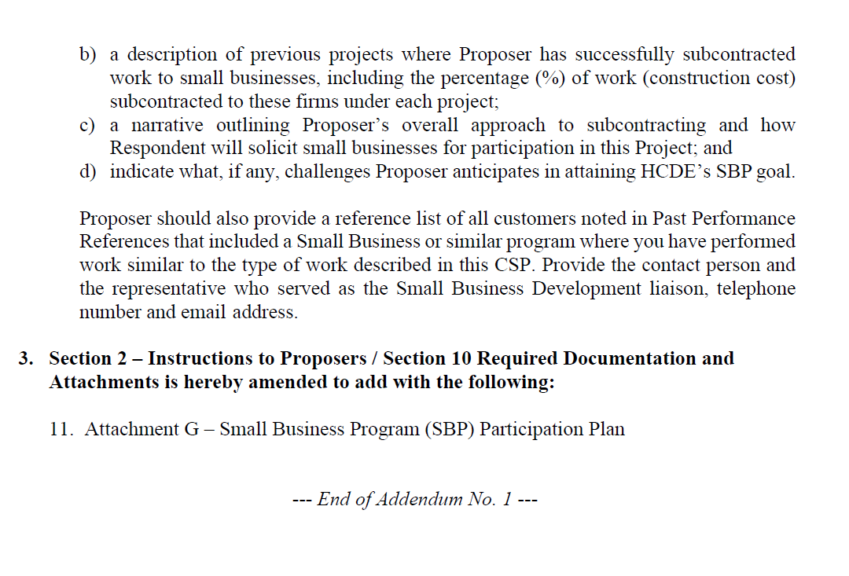
Small Business for Construction
Launch industry's first collaboration feature
This is our plan as we launch the industry's first collaboration feature

Slide 34
Content
Small Business Expenditures for FY2025-26 Year to Date (09/01/25 to 10/31/25)
Graphic
List of Small Businesses

Slide 35
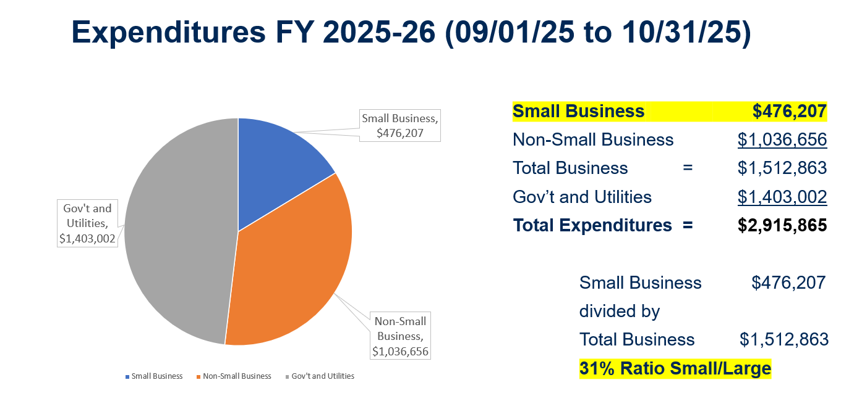
Expenditures FY 2025-26 (09/01/25 to 08/31/2026)

Slide 36
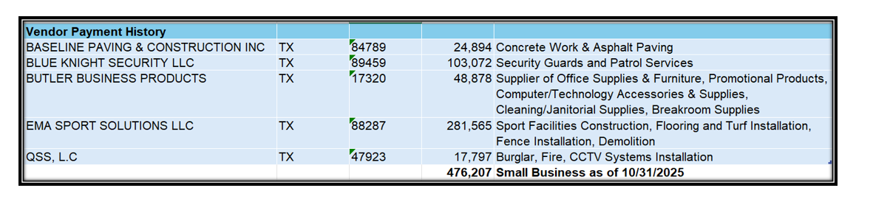
List of Small Businesses
FY 2025-26

Slide 37
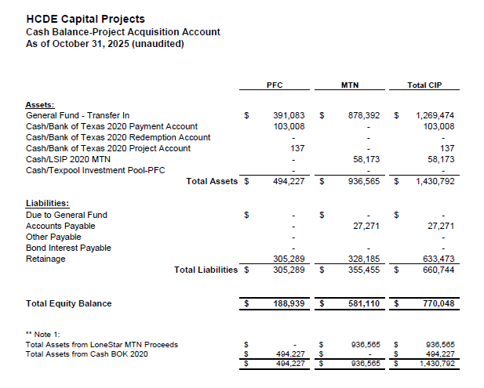

AB East School Contract $12,358,000 Awarded
Adult Ed Center Contract $15,121,000 Awarded on Oct 2021 Board Mtg
HP East Contract $7,271,000 Awarded on Nov 2021
Irvington – $11,172,589 Awarded on Jan 2024
Cash Balance –
Project Acquisition Account
As of October 31, 2025
37

Slide 38
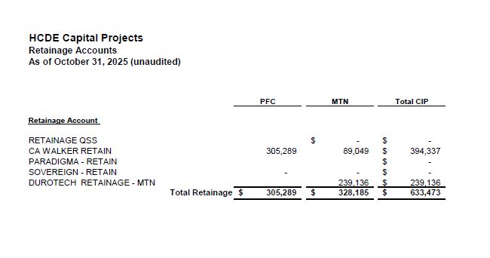
2020 MTN NOTES/2020 PFC BONDS
Pending Retainage Payable
Retainage Payable
Project Acquisition Account
As of October 31, 2025
38

Slide 39
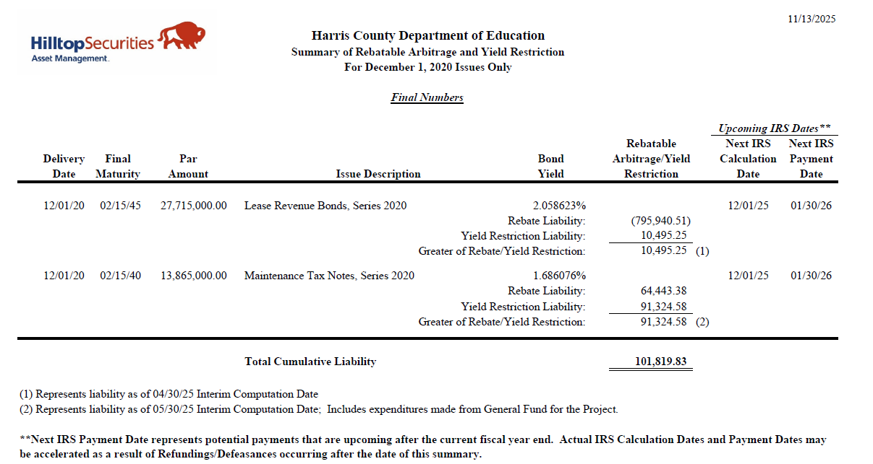
Arbitrage Calculations for 2020 Bond Issues
Calculations have been prepared for the 5th year required review.
HCDE is estimating a payment of $101,809 to the IRS for arbitrage interest above the bond yield. Funds were reserved for this contingency and were reduced from $281,000 initially.

Slide 40
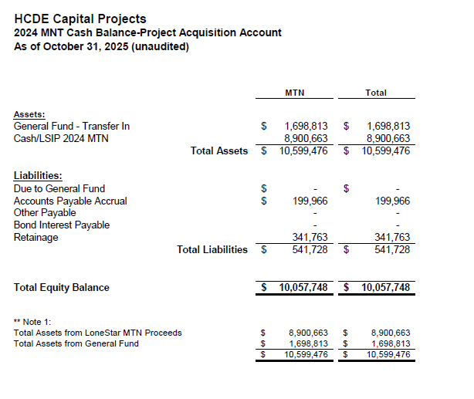
AB West $333,000 March 2024 Board Mtg
HS Barrett Station $470,000 March 2024 Board Mtg
Fortis Academy $650,000 March 2024 Board Mtg
Irvington – $9,860,000 March 2024 Board Mtg
Post Oak - $5,000,000 March 2024 Board Mtg
$16,313,000
Cash Balance –
2024 Maintenance Notes
As of October 31, 2025
40

Slide 41
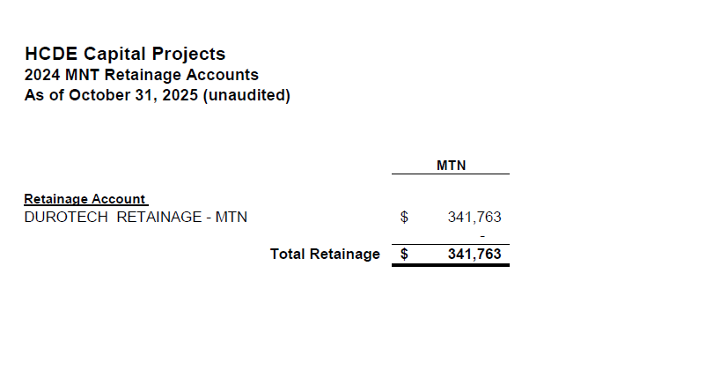
AB West $333,000 March 2024 Board Mtg
HS Barrett Station $470,000 March 2024 Board Mtg
Fortis Academy $650,000 March 2024 Board Mtg
Irvington – $9,860,000 March 2024 Board Mtg
Post Oak - $5,000,000 March 2024 Board Mtg
$16,313,000
Retainage Payable
2024 Maintenance Notes
As of October 31, 2025
41

Slide 42
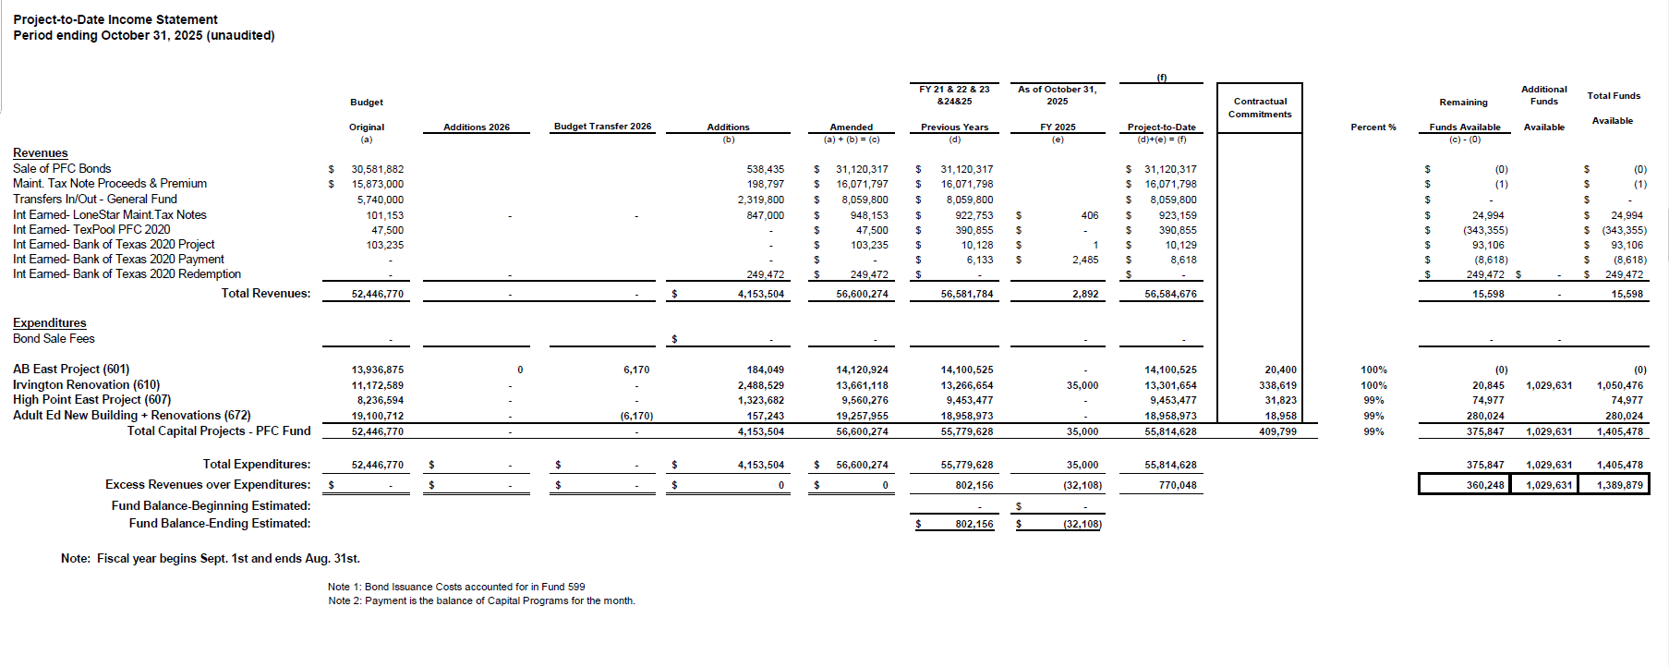
Income Statement– Project Acquisition Account
As of October 31, 2025
Arbitrage payment due on Jan 31st - $101,820
42

Slide 43
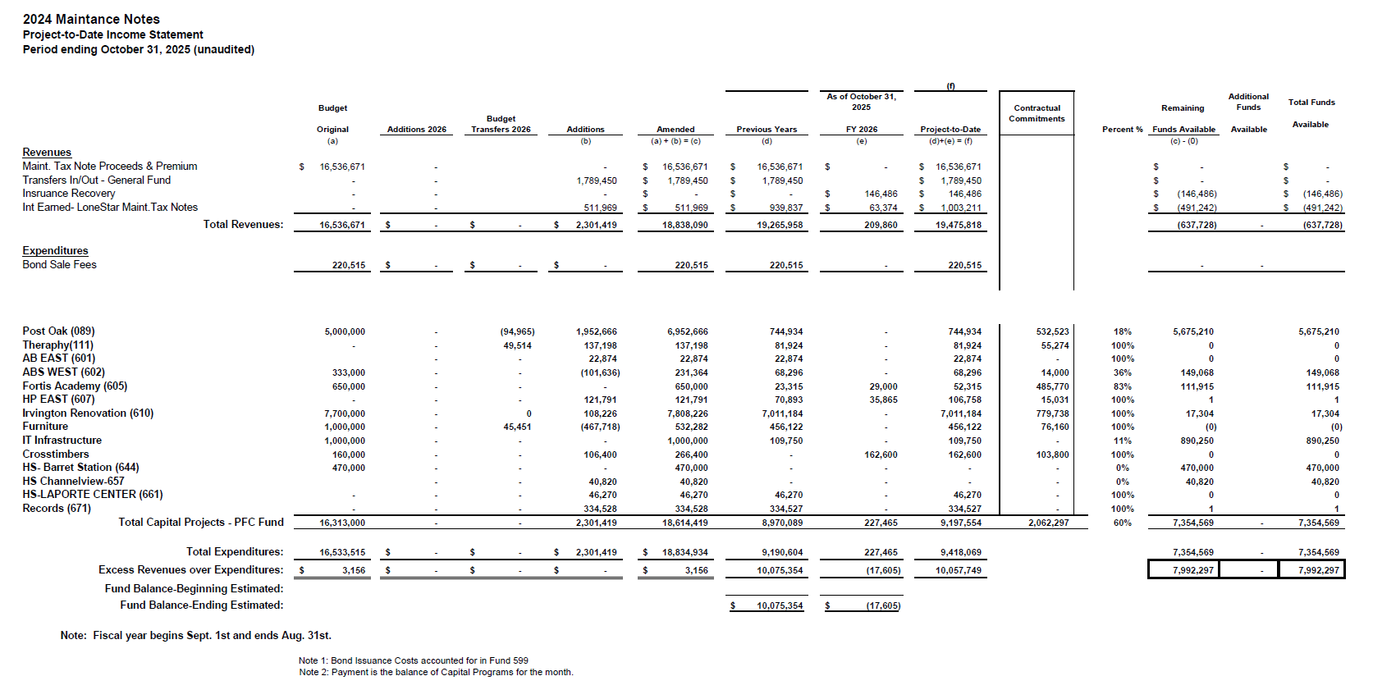
Income Statement– 2024 MNT NOTES
As of October 31, 2025
43

Slide 44
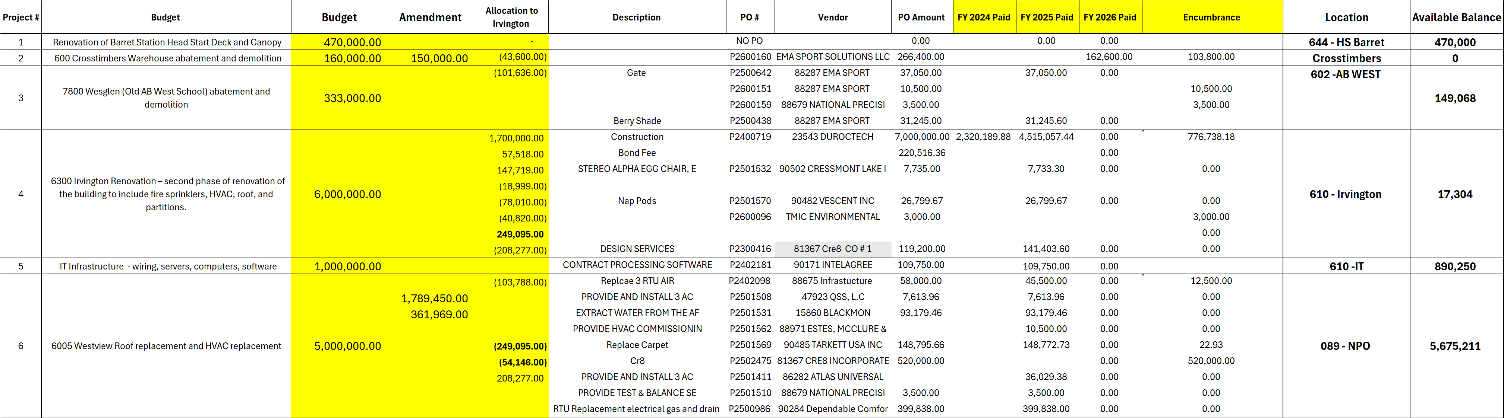
Maintenance Notes 2024 – Projects
44

Slide 45
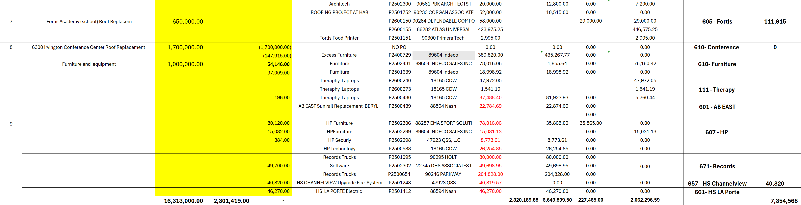
Maintenance Notes 2024 – Projects
45

Slide 46
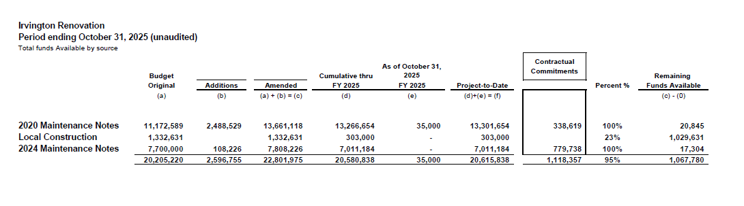
Irvington Renovation – Funds by Source As of October 31, 2025

Slide 47
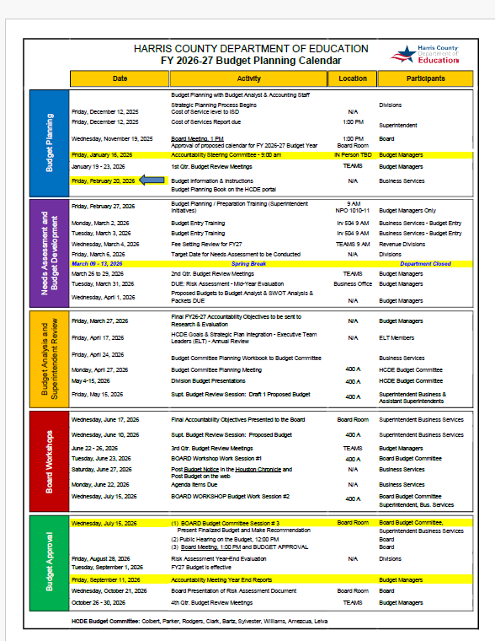

Slide 48


Interim Financial Report (unaudited)
I certify that the foregoing information is true and accurate to the best of my knowledge.
/s/ Jesus J. Amezcua, RTSBA,CPA, Ph.D., CPFIM, Asst. Supt. for Business Support Services
/s/ Marcia Leiva, MBA Chief Accounting Officer

